Slide 1
Our staff and a team of students visited the THE RIGHT MILLETS MELA organized by Department of Food Safety, Tamil Nadu at Trichy on 05-01-2023.
Our staff and a team of students visited the THE RIGHT MILLETS MELA organized by Department of Food Safety, Tamil Nadu at Trichy on 05-01-2023. They explain about the foods displayed in a stall to the District Collector Mr. Pradeep Kumar, IAS. Our students were also involved in service of snacks to the government officials during this event.

Slide 2
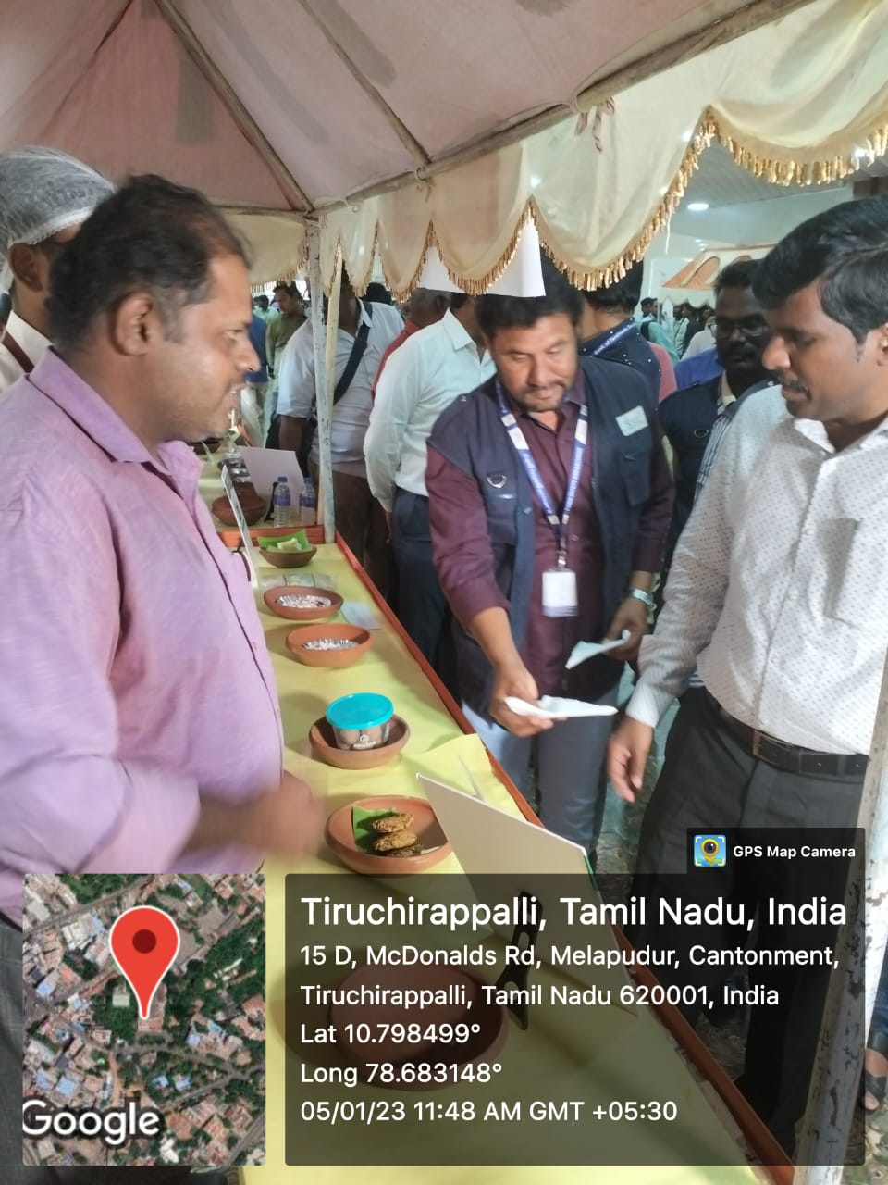
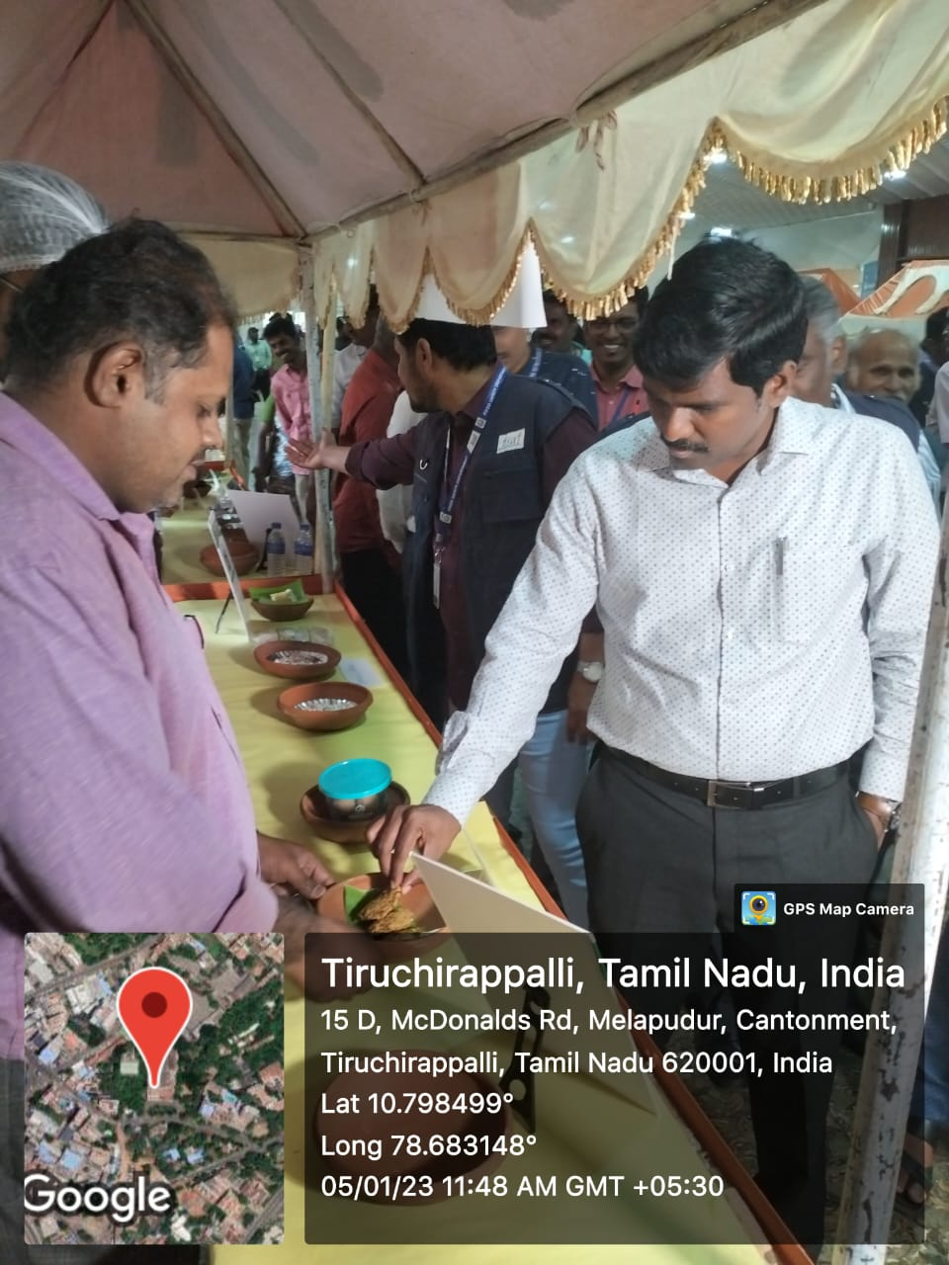
OUR STAFF AND A TEAM OF STUDENTS VISITED
THE RIGHT MILLETS MELA
ORGANIZED BY DEPARTMENT OF FOOD SAFETY, TAMIL NADU AT TRICHY ON 05-01-2023.

Slide 3
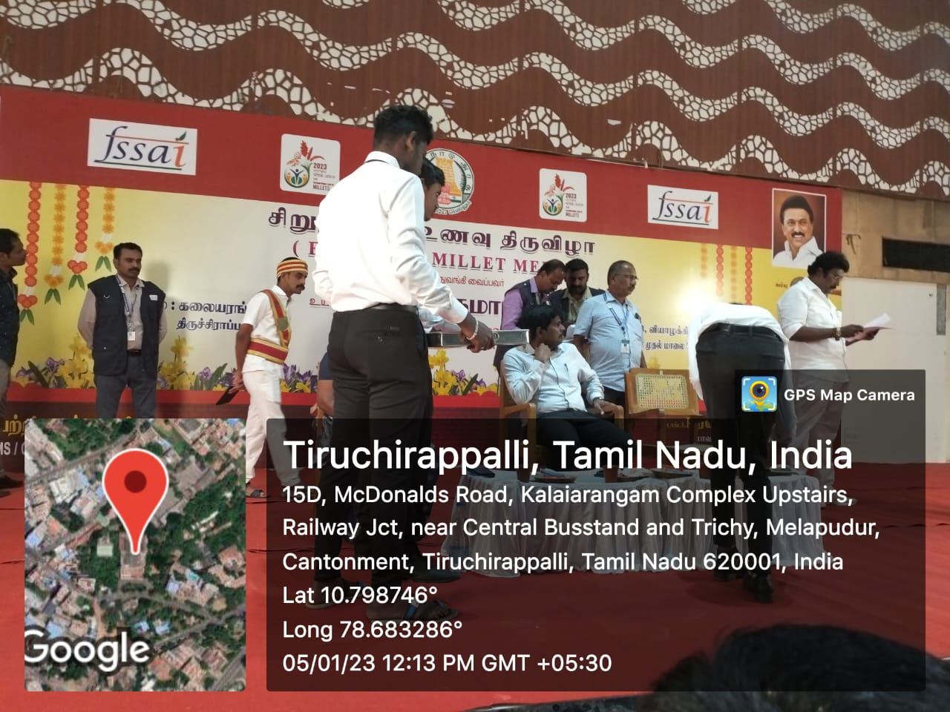
Our Students explain about the foods displayed in a stall to the District Collector Mr. Pradeep Kumar, IAS. Our students were also involved in service of snacks to the government officials during this event.

Slide 4
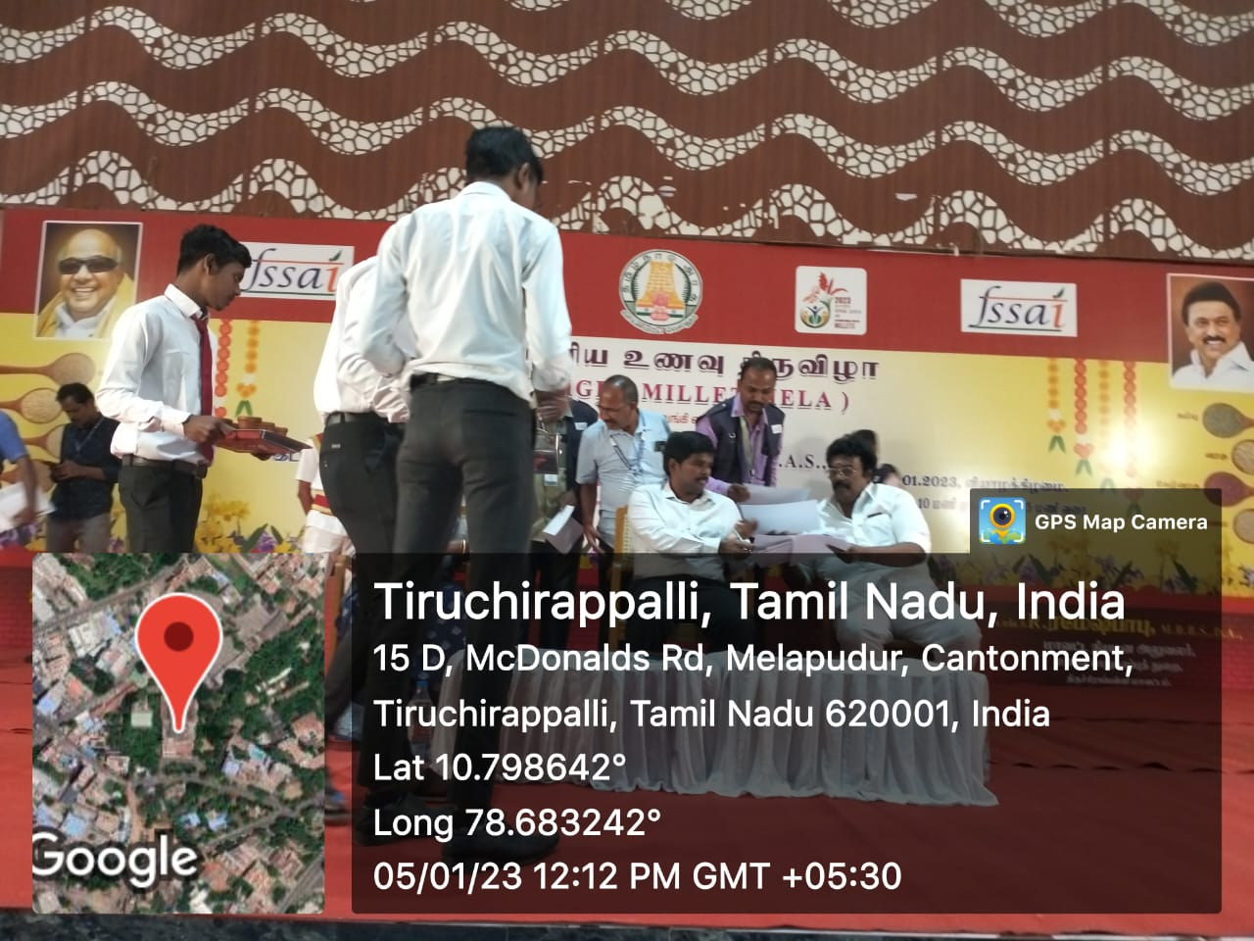
Our students were also involved in service of snacks to the government officials during this event.

